Slide 1
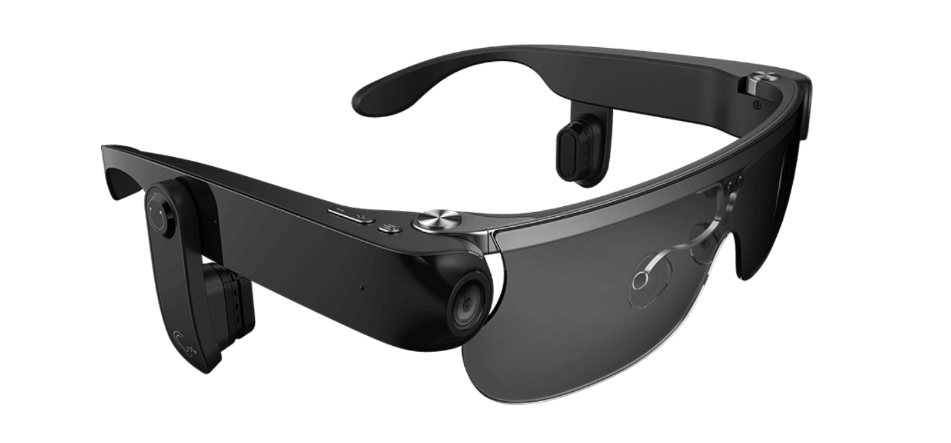
visual-assist glasses
c
Team member:
Lihan Zhao
Tianlei Shi
Zhichao Ma
Xingbo Wei
Hening Fan

Slide 2
Outline of THE PRESENTATION
Show and explain the components
Describe the Design Principles applied in the components
Show and explain how the components and features are connected

Slide 3
Components
6 components:
Camera
Microphones
Buttons
Glasses
Bone conduction headphones
Mobile application

Slide 4
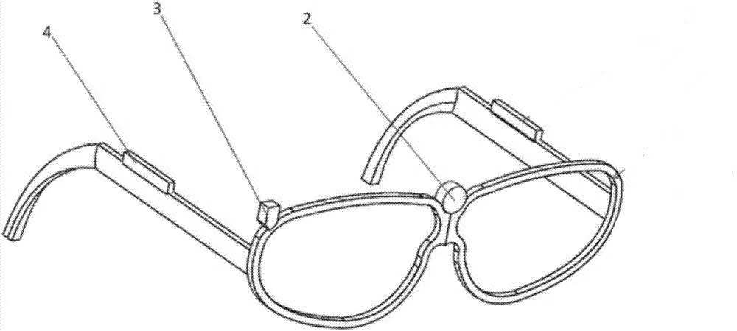
Components
1. Microphones
2,3. Camera
4. Bone conduction headphones
5.Buttons
And the main body of the glasses
1
5

Slide 5
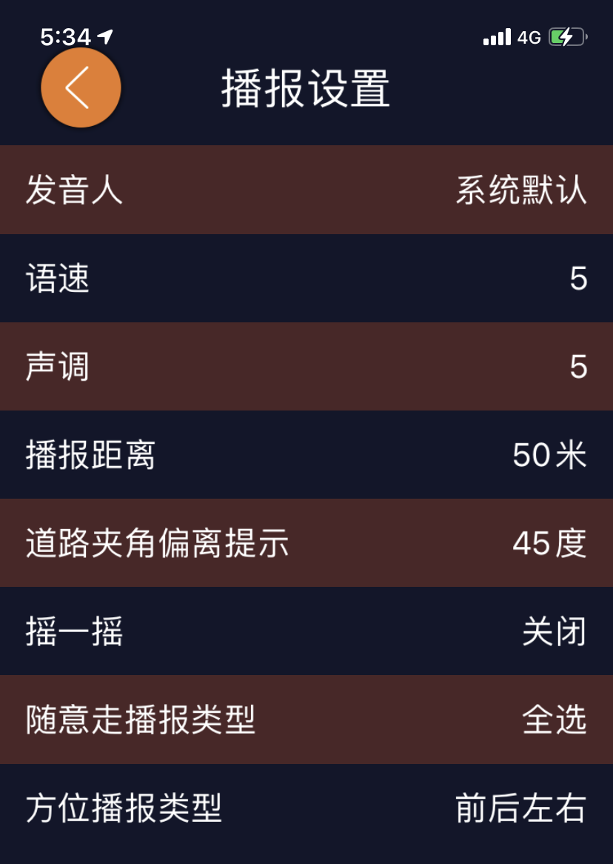
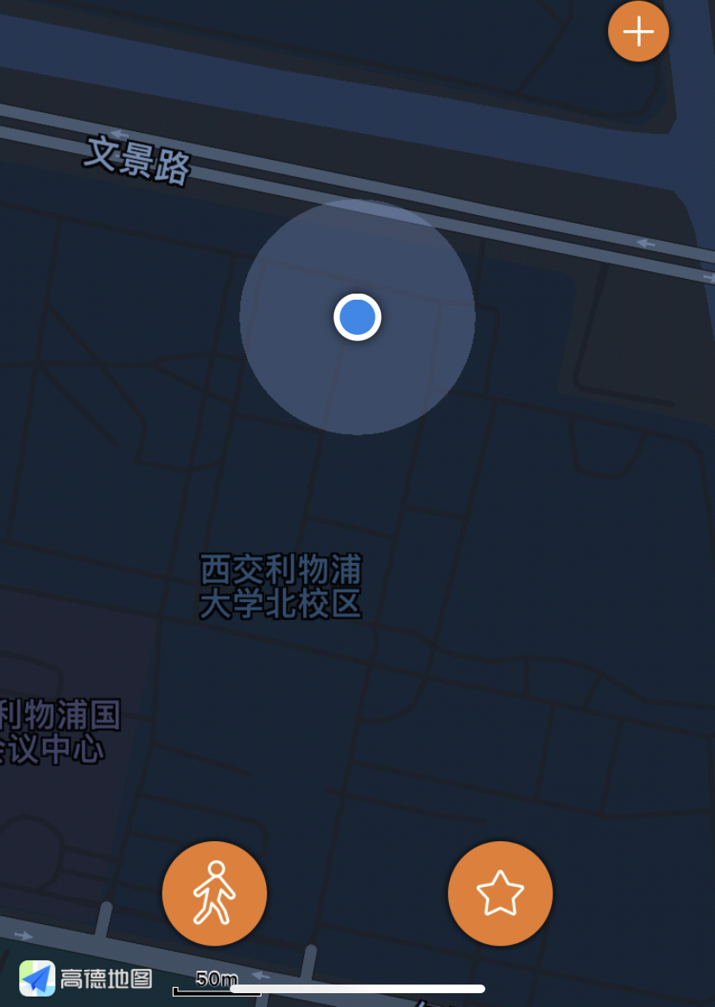
COMPONENTS
Mobile application:
A specific mobile app designed to get linked to the glasses

Slide 6
DESIGN PRINCIPLES APPLIED IN THE COMPONENTS
Camera , microphones , glasses: ‘Simple and natural dialog, mental model’
Buttons: ‘Modes easy to recognize and distinguish’
Headphones: ‘Modes easy to recognize and distinguish’ and ’Provide feedback’
App: ‘Speak the user’s language’ and ‘Structure the interface’

Slide 7
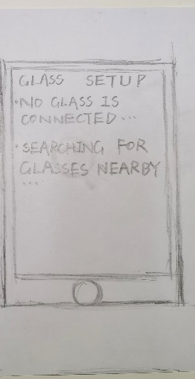
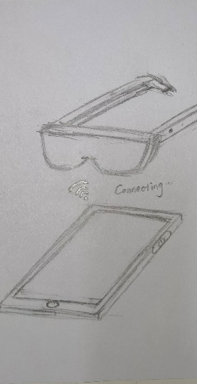
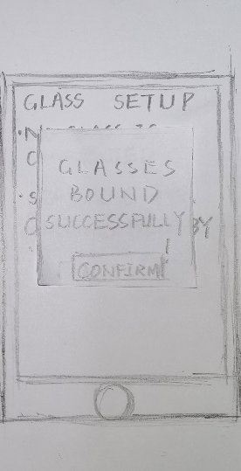

CONNECTION OF THE COMPONENTS
All the tiny components need to installed on the glasses
Blue teeth technology to connect the glasses and the app

Slide 8
connection between components and features
Glasses buttons:
Press Button Once
Navigation Mode
Press Button Twice
Recognize Mode
Long press
Reading Mode

Slide 9
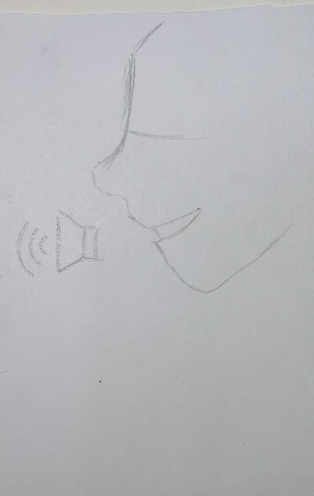
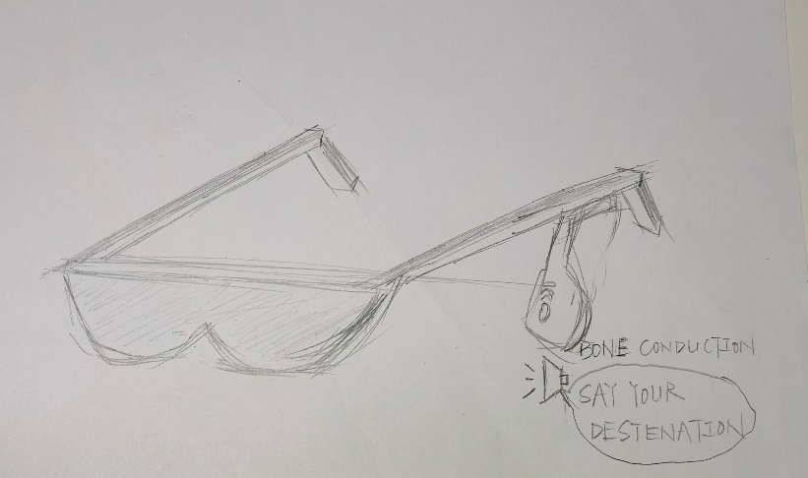
connection between components and features
Speech interaction : use audio to interact
Bone conduction earphones : transfer information

Slide 10
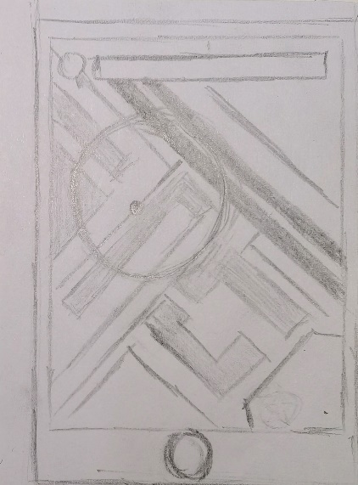
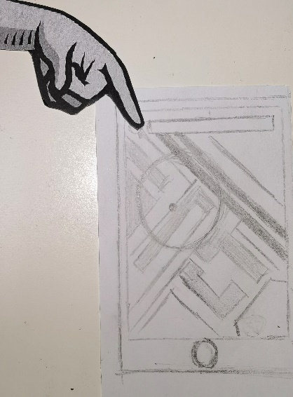
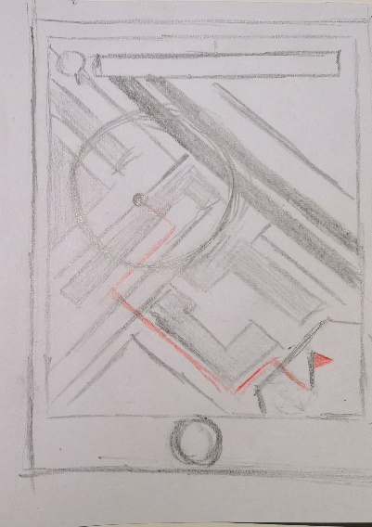
connection between components and features
App usage:

Slide 11
Results of the connection

Slide 12
VISUALIZATION PRESENTATION
Two ways of visual presentation
In the navigation mode , the app will show the navigation route on the mobile app
Family member helping mode in other mobile phones

Slide 13
Thank you !

